Slide 1
Final Presentation: Predict Diabetes Based on Diagnosis Measures
Renita Hasna Febrianti

Slide 2
01
02
03
04
TABLE OF CONTENTS
05
06
INTRODUCTION
PROBLEM
How Supervised Machine Learning Works
We want to predict that patient have a simptoms of diabetes
WHAT IS DIABETES ?
DATABASE
Get to know about diabetes and its symptoms
Using data from Kaggle Pima Indian Diabetes Dataset
EDA & MODEL
CONCLUSION & RECOMENDATION
Refer to the Notebook

Slide 3
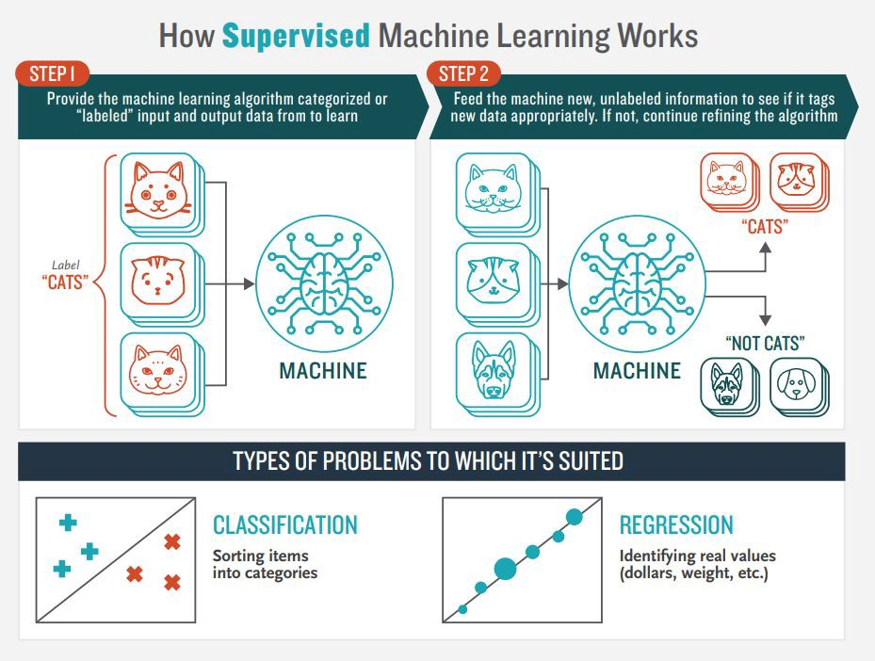
INTRODUCTION
Notes:
Classification: A classification problem is when the output variable is a category, such as “red” or “blue” or “disease” and “no disease”.
Regression: A regression problem is when the output variable is a real value, such as “dollars” or “weight”.\
Supervised learning is a learning model built to make prediction, given an unforeseen input instance. A supervised learning algorithm takes a known set of input dataset and its known responses to the data (output) to learn the regression/classification model. A learning algorithm then trains a model to generate a prediction for the response to new data or the test dataset.

Slide 4
PROBLEM
We have a data patient Pima Indian Diabetes Dataset
Prediction that the patient has a tendency to have diabetes
I explore the data and using machine learning to predict the disease
Evaluasi Model, Conclusion and Recomendation

Slide 5
WHAT IS DIABETES ?
Acccording to NIH, "Diabetes is a disease that occurs when your blood glucose, also called blood sugar, is too high.
Blood glucose is your main source of energy and comes from the food you eat.
Insulin, a hormone made by the pancreas, helps glucose from food get into your cells to be used for energy. Sometimes your body doesn’t make enough—or any—insulin or doesn’t use insulin well. Glucose then stays in your blood and doesn’t reach your cells

Slide 6
DIFFERENT TYPES OF DIABETES
Type 1
Type 2
Type 3
body does not make insulin. Your immune system attacks and destroys the cells in your pancreas that make insulin. People with type 1 diabetes need to take insulin every day to stay alive.
body does not make or use insulin well. This type of diabetes occurs most often in middle-aged and older people.
Gestational diabetes develops in some women when they are pregnant. Sometimes diabetes diagnosed during pregnancy is actually type 2 diabetes.

Slide 7
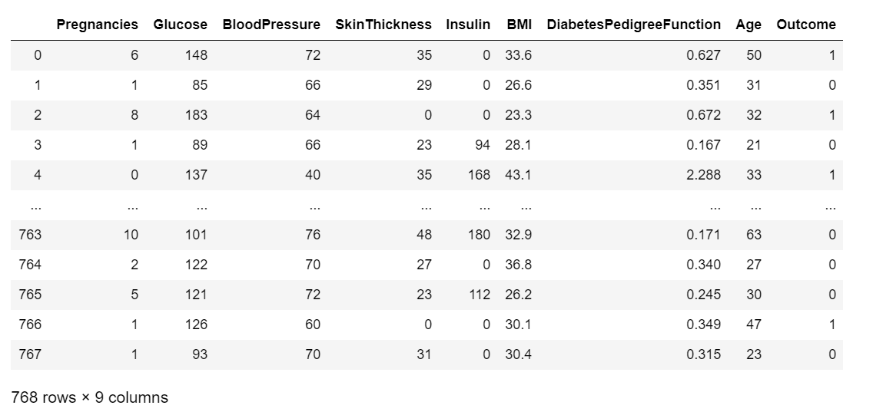
DATASET
Age: 21 - 81
Gender: Female
Location: Arizona, America

Slide 8
EXPLORE DATA ANALIST
Refer to the notebook

Slide 9
MODEL
Refer to the notebook

Slide 10
CONCLUSIONS
From accuracy score, Random Forest Classifier have a good score than other model
After cross validation , the model has quite stabile validation score and can be prone to overfitting.

Slide 11
RECOMENDATION
Overfiting can be handle with increase the feature or decrease the data.
For Machine learning Classification you can try another model such as XGBoost

Slide 12
THANKS

